Slide 1
Moosic’s Play List
By
Osazee D. Osareniro
Data Analyst
22.10.2022

Slide 2
Introduction
Moosic is a little start-up that creates curated playlists done by music experts and specialists in old and new trends

Slide 3
Present Task
Approach
List of Songs was given to be classifield into different playlists
UML's Kmeans Agorithim

Slide 4
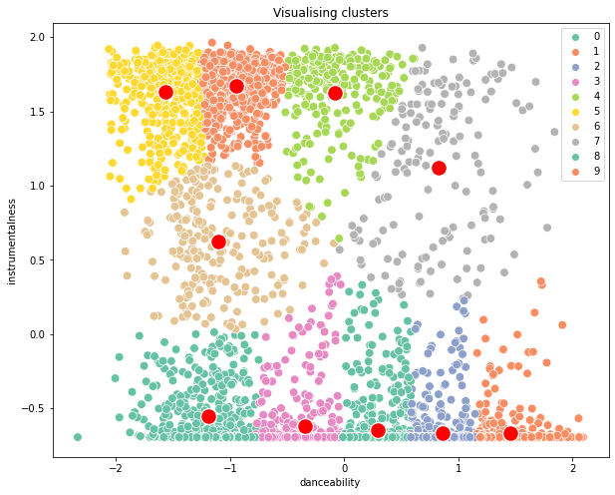
Results
Keys
0 Rock.
1 Jazz.
2 Electronic Dance Music.
3 Dubstep.
4 Techno.
5 Rhythm and Blues (R&B)
6 Country.
7 Pop
8 Indie Rock
9 Electro

